Slide 1
Spring AOP

Slide 2
Introduction
Aspect Oriented Programming (AOP) compliments OOPs in the sense that it also provides modularity. But the key unit of modularity is aspect than class.
AOP breaks the program logic into distinct parts (called concerns). It is used to increase modularity by cross-cutting concerns.
A cross-cutting concern is a concern that can affect the whole application and should be centralized in one location in code as possible, such as transaction management, authentication, logging, security etc.

Slide 3
Why use AOP?
It provides the pluggable way to dynamically add the additional concern before, after or around the actual logic. Suppose there are 10 methods in a class as given below:
class A{
public void m1(){...}
public void m2(){...}
public void m3(){...}
public void m4(){...}
public void m5(){...}
public void n1(){...}
public void n2(){...}
public void p1(){...}
public void p2(){...}
public void p3(){...}
}

Slide 4
AOP Concepts and Terminology
Aspect
Join Point
Advice
Pointcut
Target Object
AOP proxy
Weaving

Slide 5
AOP Advice Types
Before Advice
After (finally) Advice
After Returning Advice
After Throwing Advice
Around Advice

Slide 6
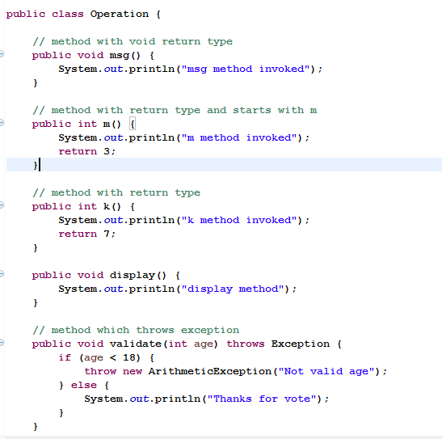
Example using xml based configuration

Slide 7
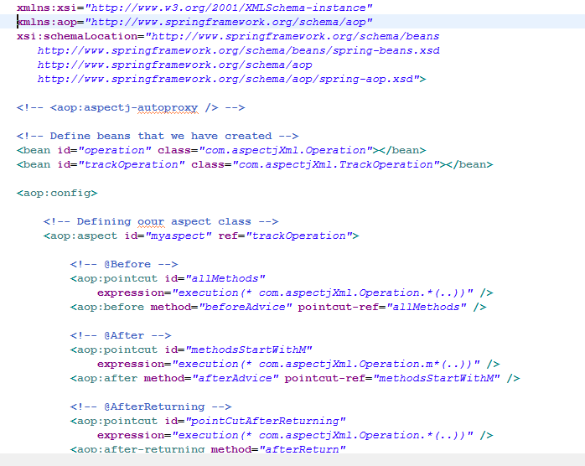
Xml configuration file

Slide 8
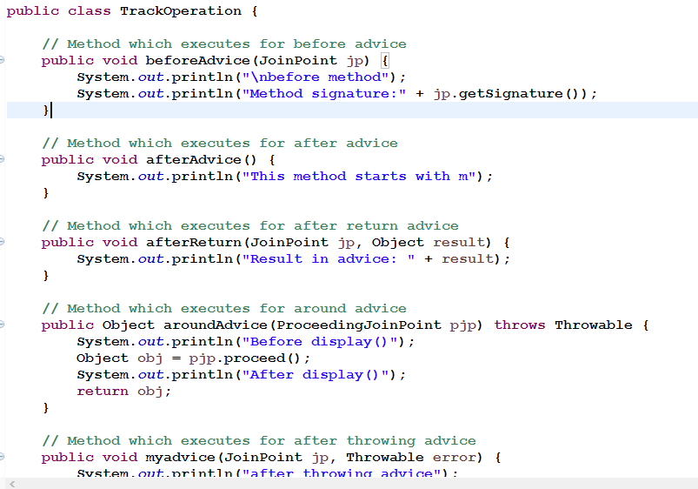
Aspect class

Slide 9
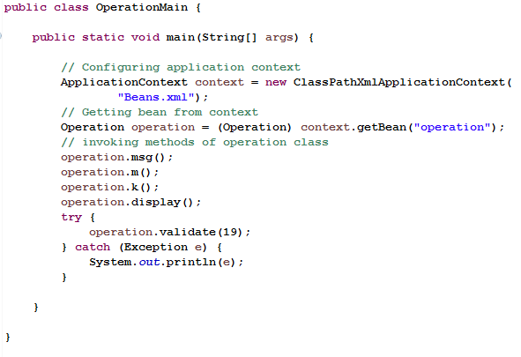
Main class

Slide 10
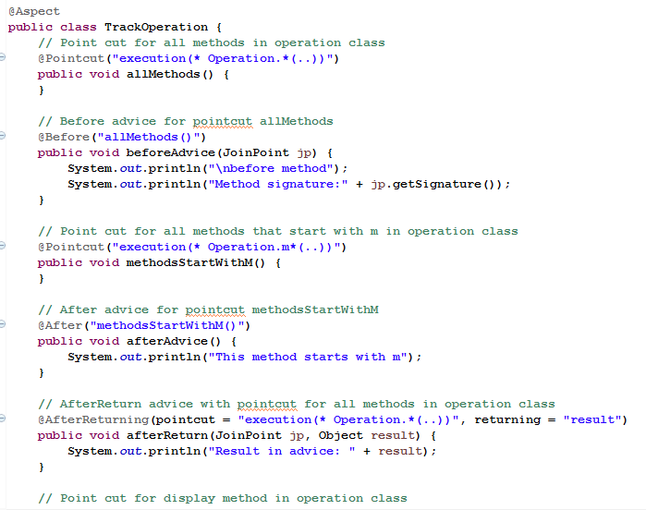
Example using annotation based configuration

Slide 11
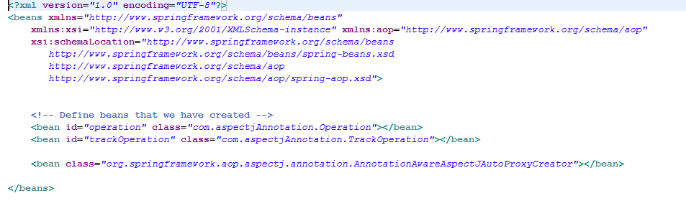
Xml file

